Slide 1
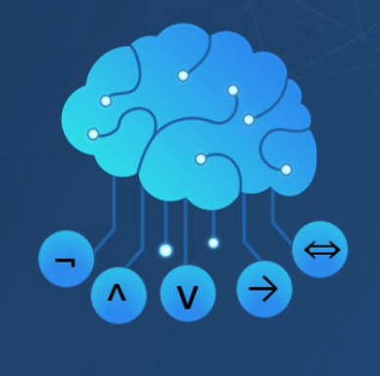
Artificial Intelligence
Propositional Logic
CS 444 – Spring 2021
Dr. Kevin Molloy
Department of Computer Science
James Madison University
Much of this lecture is taken from
Dan Klein and Pieter Abbeel AI class at UC Berkeley

Slide 2
Announcements
HW 7 is coming due.
First quiz on RL will be released tomorrow (Friday).

Slide 3
Knowledge Bases
Inference engine
Domain-independent algorithms
Knowledge base
Domain-specific content
Knowledge base = set of sentences in a formal language
Declarative approach to build an agent (or other system):
Tell it what it needs to know
Then it can Ask itself what to do, answers should follow from the KB
Agents can be viewed at the knowledge level.
i.e., what they know, regardless of how implemented
Or at the implementation level
i.e., data structures in KB and algorithms that manipulate them
Figure from Berkley AI

Slide 4
Simple Knowledge-based Agent
function KB-Agent(percept) returns an action
Static: KB, a knowledge base
t, a counter, initially 0, that indicates time
Tell(KB, Make-Percept-Sentence(percept, t))
action ← Ask(KB, Make-Action-Query(t))
Tell(KB, Make-Percept-Sentence(action, t))
t ← t + 1
return action
The agent must be able to:
Represent states, actions, etc.
Incorporate new percepts
Update internal representations of the world
Deduce hidden properties of the world
Deduce appropriate actions
Figure from Berkley AI

Slide 5
Wumpus World – PEAS Description
Performance measure gold + 1000, death – 1000
-1 per step, -10 for using the arrow
Environment
Squares adjacent to Wumpus are smelly
Squares adjacent to pit are breezy
glitter iff gold is in the same square
Shooting kills Wumpus if you are facing it
Shooting uses up the only arrow
Grabbing picks up gold if in same square
Releasing drops the gold in same square
Squeal sound means Wumpus was killed
Actuators
Left turn, right turn, forward, grab, release, shoot
Sensors
Breeze, glitter, smell
Figure from Berkley AI

Slide 6
Wumpus World Characterizations
Observable?
Partially observable – only local perception
Deterministic?
Yes – outcomes exactly specified
Episodic?
No – sequential at the level of actions
Static ?
Yes – Wumpus and pits do not move
Discrete?
Yes
Single Agent?
Yes (Wumpus is essentially a natural feature)
Figure from Berkley AI

Slide 7
Exploring A Wumpus World
Figure from Berkley AI

Slide 8
Exploring a Wumpus World
Figure from Berkley AI

Slide 9
Exploring a Wumpus World
Figure from Berkley AI

Slide 10
Exploring a Wumpus World
Figure from Berkley AI

Slide 11
Exploring a Wumpus World
Figure from Berkley AI

Slide 12
Exploring a Wumpus World
Figure from Berkley AI

Slide 13
Exploring a Wumpus World
Figure from Berkley AI

Slide 14
Exploring a Wumpus World
Figure from Berkley AI

Slide 15
Sometimes No Safe Move Exists
Breeze in (1,2) and (2, 1)
⇨no safe actions
Assuming pits uniformly distributed, (2,2) has a pit with higher probability. How much?
Smell in (1, 1)
⇨cannot move
Can use strategy of coercion:
shoot straight ahead
Wumpus was there ⇨ dead ⇨ safe
Wumpus wasn’t there ⇨ safe
Figure from Berkley AI

Slide 16
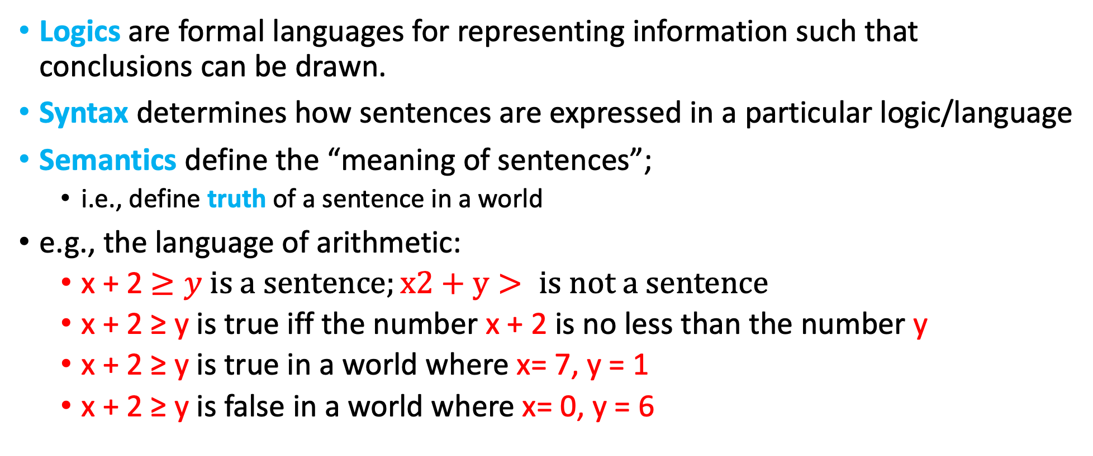
Logic In General
Logics are formal languages for representing information such that conclusions can be drawn.
Syntax determines how sentences are expressed in a particular logic/language
Semantics define the “meaning of sentences”;
i.e., define truth of a sentence in a world
e.g., the language of arithmetic:
x + 2 $≥y is a sentence;x2+y> is not a sentence$
x + 2 ≥ y is true iff the number x + 2 is no less than the number y
x + 2 ≥ y is true in a world where x= 7, y = 1
x + 2 ≥ y is false in a world where x= 0, y = 6
Figure from Berkley AI

Slide 17
Types of Logic
Logics are characterized by what they commit to as primitives
Ontological commitment: what exists – facts? Objects? Time? Beliefs?
Epistemological commitment: what states of knowledge?
Language | Ontological Commitment | Epistemological Commitment
Propositional logic | Facts | true/false/unknown
First-order logic | Facts, objects, relations | true/false/unknown
Temporal logic | Facts, objects, relations, time | true/false/unknown
Probability theory | Facts | Degree of belief
Fuzzy logic | Facts + degree of truth | Known internal value
Figure from Berkley AI

Slide 18
Reasoning with Logic
First order of business: fundamental concepts of logic representation and reasoning
independent of any logic’s particular form/type
Entailment
Second order of business: Introduction to propositional logic
Wumpus KB via propositional logic
Third order of business: Drawing conclusions
Inference and theorem proving
Figure from Berkley AI

Slide 19
Models
Can use the term model in place of possible world
Logicians typically think in terms of models, which are formally-structed worlds with respect to which truth can be evaluated
Model = mathematical abstraction that fixes the truth/falsehood of every relevant sentence
Possible models are just all possible assignments of variables in the environment
We say that a model m “satisfies” sentence 𝛼 if 𝛼 “is true in” m
Or: “m is a model of 𝛼”
M(𝛼) is the set of all models of 𝛼
Figure from Berkley AI

Slide 20
Models and Entailment
Entailment means that one thing follows from another:
KB ⊨ 𝛼
Knowledge base KB entails sentence 𝛼
iff 𝛼 is true in all worlds/models where KB is true
KB ⊨ 𝛼 iff M(KB) ⊆ M(𝛼)
e.g., KB contains “Giants won” and “Red won” entails ”Giants or Reds won”
x + y = 4 entails 4 = x + y
Entailment is a relationship between sentences (i.e., syntax) that is based on semantics.
Note: brains process syntax (or some sort).
Figure from Berkley AI

Slide 21
Quick Quiz
Given two sentences 𝛼 and 𝛽, what does this mean:
𝛼 ⊨ 𝛽
𝛼 entails 𝛽
M(𝛼) ⊆ M(𝛽)
𝛽 is satisfied in all models of 𝛼.
𝛽 may be satisfied in other models (as well).
𝛼 is stronger assertion than 𝛽.
Figure from Berkley AI

Slide 22
Hands on: Entailment in the Wumpus World
Situation after detecting nothing in [1, 1], moving right, breeze in [2,1]
Consider possible models for ?s assuming only pits
3 Boolean choices ⇨ 8 possible models

Slide 23
Wumpus Models
KB = Wumpus-world rules + observations
Figure from Berkley AI

Slide 24
Wumpus Models
KB = Wumpus-world rules + observations, 𝛼₁ = “[1,2] is safe”
KB ⊨ 𝛼_{1,} proved by model checking
Figure from Berkley AI

Slide 25
Wumpus Models
KB = Wumpus-world rules + observations, 𝛼₂ = “[2,2] is safe”,
KB ⊭ 𝛼₂
Figure from Berkley AI

Slide 26
Entailment to Logical Inference
Entailment can be used to derive logical conclusions
i.e., carry out logical inference
A straightforward algorithm to carry out inference:
Model Checking
Model checking enumerates all possible models to check that 𝛼 is true in all models where KB is true. i.e., M(KB) ⊆ M(𝛼)
To understand entailment and inference: haystack and needle analogy
Consequences of KB are a haystack, 𝛼 is a needle.
Entailment = needle in haystack
Inference = finding it
We need inference procedures to derive 𝛼 from a given KB.
Figure from Berkley AI

Slide 27
Inference
KB ⊢_{i} 𝛼 = sentence 𝛼 can be derived from KB by procedure i
Soundness: inference procedure i is sound if
whenever KB ⊢_{i} 𝛼, it is also true that KB ⊨ 𝛼 (does not make stuff up)
Completeness: inference procedure i is complete if
whenever KB ⊨ 𝛼, it is also true that KB ⊢_{i} 𝛼 (finds the needle in haystack)
Preview: we will define a logic (first-order logic) which is expressive enough to say almost anything of interest, and for which there exists a sound and complete inference procedure.
That is, the procedure will answer any question whose answer follows from what is known by the KB.
First step, propositional logic.
Figure from Berkley AI

Slide 28
Propositional Logic: Syntax
Propositional logic is the simplest logic – illustrates basic ideas
Atomic sentences consist of a single propositional symbol
e.g., Propositional symbols P₁, P₂, etc. are atomic sentences
Each such symbol stands for a proposition that can be true or false.
e.g., W1,3 stands for proposition that Wumpus is in [1,3]
Two propositions with fixed meaning: True and False
Complex sentences build over atomic ones via connectives:
negation, conjunction, disjunction, implication, biconditional
Figure from Berkley AI

Slide 29
Propositional Logic: Syntax
If S is a sentence, ¬S is a sentence (negation)
A (positive) literal is an atomic sentence; a (negative) literal is a negated atomic sentence
If S₁ and S₂ are sentences S₁ ∧ S₂ is a sentence (conjunction)
S₁ and S₂ are called conjuncts
If S₁ and S₂ are sentences S₁ ∨ S₂ is a sentence (disjunction)
S₁ and S₂ are called disjuncts
If S₁ and S₂ are sentences, S₁ ⟹ S₂ is a sentence (implication/ conditional)
S₁ is called premise/antecedent; S₂ is called conclusion or consequent
Implication also known as rule or if-then statement
If S₁ and S₂ are sentences, S₁ ⇔ S₂ is a sentence (biconditional)
Figure from Berkley AI

Slide 30
Propositional Logic: Semantics (Backus-Naur Form (BNF))
BNF is an ambiguous formal grammar for propositional logic
Sentence → AtomticSentence | ComplexSentence
AtomicSentence → True | False | P | Q | ...
ComplexSentence → (Sentence) | [Sentence] | ¬Sentence | Sentence ∧ Sentence …
We add operator precedence to disambiguate
Operator precedence (from highest to lowest): ¬, ∧, ∨, ⟹, ⇔
Figure from Berkley AI

Slide 31
Propositional Logic: Semantics
Each model specifies true/false for each propositional symbol
e.g., P_{1,2} P_{2,2} P_{3,1}
true true false
This specific model: m₁ = {P_{1,2} = true, P_{2,2} = true, P_{3,1} = false)
2³ = 8 possible models, feasible to enumerate
Rules for evaluating truth with respect to a model m:
¬S is true iff S S is false
S₁ ∧ S₂ is true iff S₁ is true and S₂ is true
S₁ ∨ S₂ is true iff S₁ is true or S₂ is true
S₁ ⟹ S₂ is true iff S₁ is false or S₂ is true
i.e. is false iff S₁ is true and S₂ is false
S₁ ⇔ S₂ is true iff S₁ ⟹ S₂ is true and S₂ ⟹S₁ is true
¬P_{1,2} ∧ (P_{2,2} ∨ p_{3,1}) = true ∧ (false ∨ true) = true ∧ true = true
Figure from Berkley AI

Slide 32
Truth Table for Connectives
P | Q |  | ¬P | P ∧ Q | P ∨ Q | P ⟹ Q | P ⇔ Q
false | false |  | true | false | false | true | true
false | true |  | true | false | true | true | false
true | false |  | false | false | true | false | false
true | true |  | false | true | true | true | true
Figure from Berkley AI

Slide 33
Wumpus World Sentences in Propositional Logic
Let P_{i,j} be true if there is a pit in [i, j]
Let B_{i,j} be true if agent is in [i, j] and perceives a breeze
Let W_{i,j} be true if there is a Wumpus in [i, j]
Let S_{i,j} be true if agent is in [i, j] and perceives a stench
… you can define other atomic sentences
Percept sentences part of KB:
No pit, no breeze in [1, 1], but breeze perceived when in [2, 1]
R₁ : ¬P_{1,1}; R₄ : ¬B_{1,1} R₅: B_{2,1}
Rules in KB: “Put cause breezes in adjacent squares” eqv. to “Square is breeze iff adjacent pit”.
R₂ : B_{1,1} ⇔ (P_{1,2} ∨ P_{2,1})
R₃: B_{2,1} ⇔ (P_{1,1} ∨ P_{2,2} ∨ P_{3,1})
Figure from Berkley AI

Slide 34
Truth Tables for Inference: Model Checking by Enumeration
B_{1,1} | B_{2,1} | P_{1,1} | P_{1,2} | P_{2,1} | P_{2,2} | P_{3,1} |  | R₁ | R₂ | R₃ | R₄ | R₅ |  | KB
false false … false | false false … true | False False … false | False False … false | False False … false | False False … false | False True … false |  | true True … true | True True … true | true False … false | true True … true | false False … true |  | False False … false
False False False | true True true | False False False | False False false | False False false | False True true | True False true |  | True True true | True True true | True True true | True True true | True True true |  | True True true
False … true | True … true | False … true | False … true | True … true | False … true | False … true |  | True … false | False … true | False … true | True … false | True … true |  | False … false
Enumerate rows (different assignments to symbols); rows are possible models
If KB is true in a row/model, check that 𝛼 is true, if not, entailment does not hold
If entailment not broken over all rows where KB is true, then 𝛼 is entailed
Figure from Berkley AI

Slide 35
Inference by Enumeration
function TT-Entails?(KB, 𝛼) returns true/false
Inputs: KB (the knowledge base), a sentence in proposition logic
𝛼, the query, a sentence in propositional logic
symbols ← a list of the propositional symbols in KB and 𝛼
Return TT-Check-All(KB, 𝛼, symbols,[])
function TT-Check-All(KB, 𝛼, symbols, []) returns true/false
if Empty?(symbols) then
if PL-TRUE?(KB, model) then return PL-TRUE(𝛼, model)
else return true;
else do
P ← First(symbols); rest ←Rest(symbols)
return TT-Check-All(KB, 𝛼, rest, Extend(P, true, model)) and
TT-Check-All(KB, 𝛼, rest, Extend(P, false, model))
O(2^{n}) for n symbols, problem is co-NP-complete.
Figure from Berkley AI

Slide 36
Proof Methods
Proof methods divide into (roughly) two kinds:
Model checking:
Truth table enumeration (always exponential in n)
Improved backtracking, e.g., Davis-Putnam-Logemann-Loveland
Backtracking with constraint propagation, backjumping
Heuristic search in model space (sound but incomplete) e.g., min-conflicts, etc.
Theorem Proving/Deductive Systems: Application of inference rules
Legitimate (sound) generation of new sentences from old
Proof = a sequence of inference rule applications
Typically requires translation of sentence into a normal form

